Slide 1
Travelling Salesperson Problem
Hardware Accelertor
Presenter: 林修賢

Slide 2
Outline
Problem Description
TSP Algorithm &Hardware & Its Optimization (Original Version )
TSP_DP Algorithm
TSP_DP Hardware Implementation
Opt1_algorithm
Opt2_double _array
Opt3_col_partition
Opt4_compress_memory
Analysis & Conclusion
https://github.com/showlin/2022NYCU-HLS-Lab-B---Travelling-Salesperson-Problem-Hardware-Accelertor

Slide 3
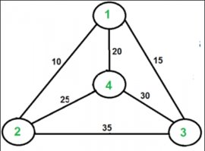
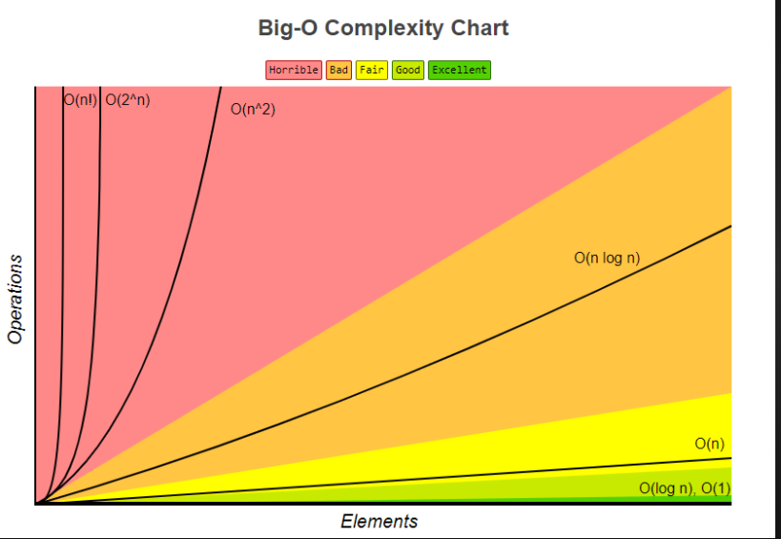

Problem Description
Travelling salesman problem(TSP):
Given a list of cities and the distances between each pair of
cities, finding shortest possible route that visits each city
exactly once and returns to the origin city.
NP-hard problem, its time complexity is O(N!)

Slide 4
TSP Algorithm (Naive)
Find all cities path permutations --> O( (N-1)! )
Ex: There are cities 1 2 3.
(3!) = 6 , (2!) = 2
1->2->3 | 2->3->1 | 3->1->2 are same
1->3->2 | 3->2->1 | 2->1->3 are same
Every path length need O(N) computation
Ex: path 1->2->3 .
Distance12+Distance23+Distance31
Total complexity is O(N!)

Slide 5
TSP Hardware
TSP kernel
Main
For( i =0; i<(n-1)!; i=i+1)
TSP kernel
compute
N*N
Distance
Shortest
Path
distance
min
N*N bram
distance0[N][N]
Shortest
Path

Slide 6
TSP Hardware
Ex: N=13 , index= 0
Permutation is 1 2 3 4 5 6 7 8 9 10 11 12 13
Ex: N=13 , index= 479001599
Permutation is 13 12 11 10 9 8 7 6 5 4 3 2 1
compute
Index i
drcorder
permutation
N*N reg
distance0[N][N]
accumulator

Slide 7

TSP Hardware optimization
TSP kernel
distance1
distance2
For( i =0; i<(n-1)!; i=i+2)
min
min
i
Compute
Shortest
Path1
Shortest
Path2
i+1
Compute
N*N bram
distance0[N][N]
N*N bram
distance1[N][N]
min
Shortest

Slide 8
TSP_DP Algorithm
1 2
3 4 5 6
Naïve TSP:
Time complexity O(n!)
Space complexity O(n^2)+O(1)
Observation
We compute same permutation repeatedly
We only care the last city of a segment of permutation.
Complexity degrade from permutation to combination
DP TSP:
Time complexity O(2^n * n^2)
Space complexity O(2^n * n)
1 2
3 4 5 6
3 4 5 6
1
2
3 4 5 6
2
1
3456
3546
4356
4536
5346
5436
We only keep the minimum value of that combination
Ideal 4500x speed up
(sw implement 4300x )
N=13
Naïve TSP: 6227020800
DP TSP : 1384448
345
6

Slide 9
TSP_DP Space complexity
DP TSP:
Time complexity O(2^n * n^2)
Space complexity O(2^n * n)
We use bit to present the number combination O(2^n)
Ex: when N=3, 000={}, 001={0}, 010={1}, 011={0,1}…...111={0,1,2}
For every combination, we should record every bit for last bit situation O(n)
Ex: when N=4, we know 1101 means {0,2,3}
So we need O(2^n)*O(n) space
02
3
23
0
03
2

Slide 10
TSP_DP Time complexity
DP TSP:
Time complexity O(2^n * n^2)
Space complexity O(2^n * n)
How do we compute a block?
For every block, we cost O(N) to compute
Example : N=4,{0,2,3},last bit is 3
2
0
0
2
distance03
distance23
min
02
3

Slide 11
Opt1_algorithm basic -ii2
TSP_DP kernel
For( i =0; i<2^n; i=i+1)
For( j =0; j<n; j=j+1)
For( k =0; k<n; k=k+1)
v[i][j] = min( v[i][j],v[~(~i | 1<<j)][k] + int(distance[j][k]) ) ;
reg
distance[N][N]
SRAM
v[2^N][N]
min
Shortest

Slide 12
TSP_DP Memory access
M: 0~2^n-1
N : 0~n-1
DP TSP:
V[M-1][0]
V[0][1]
V[M-1][0]
V[M-1][0]
V[0][N-1]
V[0][0]
V[M-1][0]
V[1][1]
V[M-1][0]
V[M-1][0]
V[1][N-1]
V[1][0]
reg
distance[N][N]
V[2][0]
V[2][1]
V[M-1][0]
V[M-2][1]
V[M-1][0]
V[M-1][0]
V[M-2][N-1]
V[M-2][0]
V[M-1][0]
V[M-1][1]
V[M-1][0]
V[M-1][0]
V[M-1][N-1]
V[M-1][0]

Slide 13
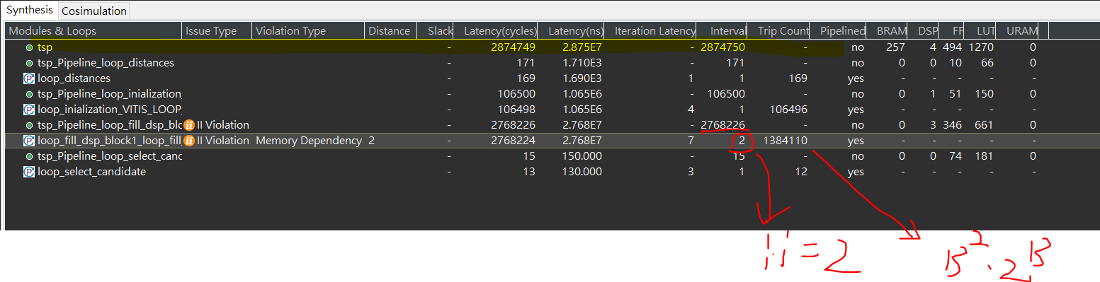
Analysis
每次都對同塊記憶體做一次讀一次寫，所以必定要stall一次(ii=2)。
13^2*2^13大概是140萬，結果因為最內層ii=2，硬生生的變成280萬cycle....

Slide 14
Opt2_double _array ii1
TSP_DP kernel
For( i =0; i<2^n; i=i+1)
For( j =0; j<n; j=j+1)
For( k =0; k<n; k=k+1)
if( is_odd(i) ){
t = std::min(t,v0[~(~i | 1<<j)][k] + int(distances[j][k]) ) ;
v1[i][j] = t;
}
else{
t = std::min( t,v1[~(~i | 1<<j)][k] + int(distances[j][k]) ) ;
v0[i][j] = t;
}
reg
distance[N][N]
SRAM
v0[2^N][N]
SRAM
v1[2^N][N]
min
Shortest

Slide 15
TSP_DP Memory access
M: 0~2^n-1
N : 0~n-1
DP TSP:
V[M-1][0]
V1[0][1]
V[M-1][0]
V[M-1][0]
V1[0][N-1]
V[M-1][0]
V1[0][0]
V0[0][1]
V[M-1][0]
V[M-1][0]
V0[0][N-1]
V0[0][0]
V[M-1][0]
V1[1][1]
V[M-1][0]
V[M-1][0]
V1[1][N-1]
V[M-1][0]
V1[1][0]
V0[1][1]
V[M-1][0]
V[M-1][0]
V0[1][N-1]
V0[1][0]
V0[2][0]
V0[2][1]
V1[2][0]
V1[2][1]
V[M-1][0]
V[M-1][0]
V1[M-2][1]
V[M-1][0]
V[M-1][0]
V1[M-2][0]
V1[M-2][N-1]
V[M-1][0]
V0[M-2][1]
V[M-1][0]
V0[M-2][0]
V0[M-2][N-1]
V[M-1][0]
V[M-1][0]
V1[M-1][1]
V[M-1][0]
V[M-1][0]
V1[M-1][0]
V1[M-1][N-1]
V[M-1][0]
V0[M-1][1]
V[M-1][0]
V0[M-1][0]
V0[M-1][N-1]
reg
distance[N][N]

Slide 16
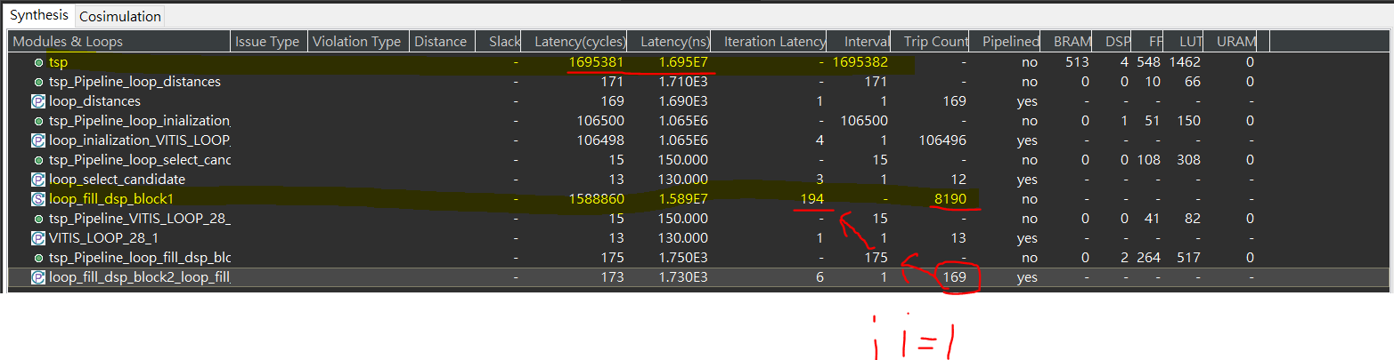
Analysis
我發現每次讀跟寫memory的address都差1bit，所以我直接複製用一塊記憶體，就不會每次讀寫都產生stall了
雖然有一些overhead，但實際值1695382跟理論上最佳化([2^N]*N*N,N=13) =1384448，算是同一個量級的

Slide 17
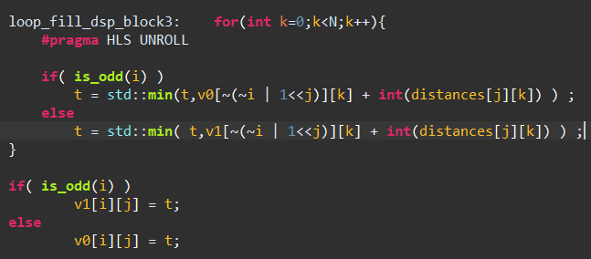
Opt3_col_partition
TSP_DP kernel
For( i =0; i<2^n; i=i+1)
For( j =0; j<n; j=j+1)
Bram
distance[N][N]
SRAM
v0[2^N][N]
SRAM
v1[2^N][N]
min
Shortest

Slide 18
TSP_DP Memory access
M: 0~2^n-1
N : 0~n-1
DP TSP:
V[M-1][0]
V1[0][1]
V[M-1][0]
V[M-1][0]
V1[0][N-1]
V[M-1][0]
V1[0][0]
V0[0][1]
V[M-1][0]
V[M-1][0]
V0[0][N-1]
V0[0][0]
V[M-1][0]
V1[1][1]
V[M-1][0]
V[M-1][0]
V1[1][N-1]
V[M-1][0]
V1[1][0]
V0[1][1]
V[M-1][0]
V[M-1][0]
V0[1][N-1]
V0[1][0]
V0[2][0]
V0[2][1]
V1[2][0]
V1[2][1]
V[M-1][0]
V[M-1][0]
V1[M-2][1]
V[M-1][0]
V[M-1][0]
V1[M-2][0]
V1[M-2][N-1]
V[M-1][0]
V0[M-2][1]
V[M-1][0]
V0[M-2][0]
V0[M-2][N-1]
V[M-1][0]
V[M-1][0]
V1[M-1][1]
V[M-1][0]
V[M-1][0]
V1[M-1][0]
V1[M-1][N-1]
V[M-1][0]
V0[M-1][1]
V[M-1][0]
V0[M-1][0]
V0[M-1][N-1]
reg
distance[N][N]

Slide 19
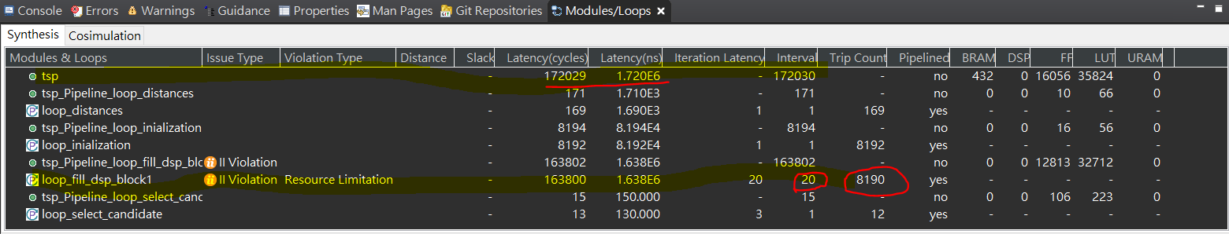
Analysis
我把loop3 unroll後，他也自動幫我把loop2 unroll了，原本每次loop 2要花169cycle，現在每次只要花20cycle，理論上我切成13塊，如果可以完全平行就可以降成13，但在loop轉換時會有一些data dependency的over heap，那個是沒辦法消除了。
理想值([2^N]*N*N/N,N=13)=106,496 跟我們實際172030其實是一樣量級，因為沒有完全平行，且當計算量越小時，memory 初始化所花的時間就會比較顯著。

Slide 20
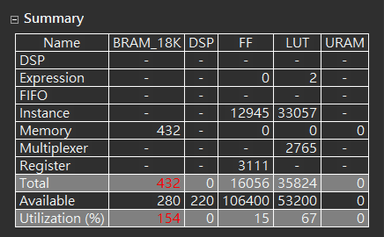
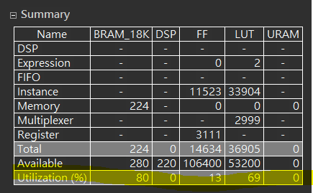
Memory utilization
Compress array by encoding address
(優化3時的使用資源)
(優化4時的使用資源)

Slide 21
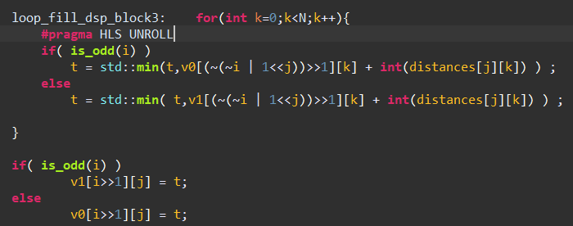
Opt4_compress_memory
TSP_DP kernel
For( i =0; i<2^n; i=i+1)
For( j =0; j<n; j=j+1)
Bram
distance[N][N]
SRAM
v0[2^N][N]
SRAM
v1[2^N][N]
min
Shortest

Slide 22
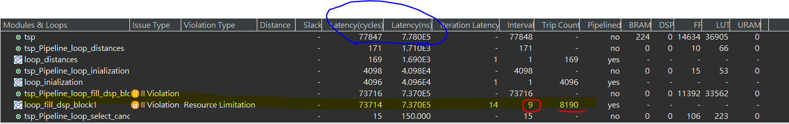
Speed up
幫我第二層loop自動做unloop，20 cycle -> 9 cycle
總時間也從剛剛的1.716E6 s 變成7.78E5 s

Slide 23
Conclusion
Software
1.naive version : 43.71s
2.Dp version : 0.01s
Hardware
Baseline_Reference : 1.4s
Optimal_Reference : 0.1s
V1 : 0.028s
V2 : 0.017s
V3 : 0.0017s
V4 : 0.00078s
Conclusion
My best design TSP_V4 is 13X faster then software dp_tsp, 141X fast then hardware Optimal_Reference.

Slide 24
Thanks for your listening.

